Slide 1
Immersive Python Workshop
Day 2
Please sign in!
bit.ly/4fHMaxS
Access shared notes
bit.ly/ipw-aug2025
Python for:
Geospatial Data
Sentiment Analysis
Data Visualization
Managing Python Projects with GitHub
AI for Writing Python Code

Slide 2
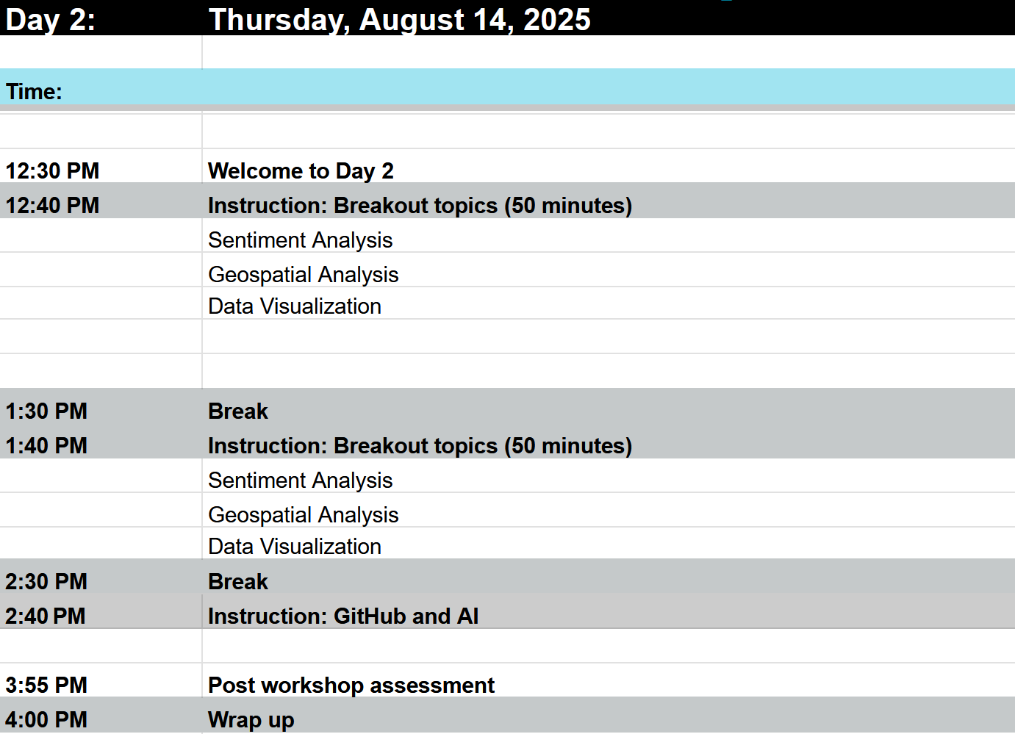
Day 2 Schedule

Slide 3
Logistics
Shared notes document (https://bit.ly/ipw-aug2025)
New URLs for materials are provided here
Asking questions
Food
Timing of breaks
Bathroom locations
Logging in to the computers
Workshop materials and slides will be posted on GitHub
Notes:
The following Zoom features are perhaps familiar to many people by now, however we would like to spotlight some of the zoom features we’re suggesting you may use today. The image shown is a representation of what your zoom screen most likely displays on your device.
Hover your mouse over the bottom of your Zoom window to see the icons.
First note the person icon, highlighted in a red box. Click and open the “Participants” window. If you click next on “More” you should see the option to rename your profile to your preferred name. This can also be done by going to your profile picture in the zoom gallery and clicking on the three ellipses “...” - you can update your profile picture here as well.
2nd, use the chat icon, highlighted in a blue box on this image, to open your chat window. Reminder to type the words “QUESTION” or “HELP” with your comments. Our helpers and hosts will be monitoring the chat. Please type a greeting to test your chat.
Finally, our instructors may be using Zoom reactions during their lesson. This image shows the reactions icon, a smiley face, highlighted in a green box. Click on your reactions icon below our slide, and it should open options like shown in the larger green box. Wave, thumbs up, a green circle with a white check mark for “yes” and a red circle with a white x for “no.”.

Slide 4
Software Installation Support
Python (https://www.python.org/downloads/)
Make sure you can install new Python packages using the Terminal (MacOS) or Command Prompt (Windows)
Try the following command on your PC: python -m pip install rasterio
Try the following command on your Mac: python3 -m pip install rasterio
VSCode (https://code.visualstudio.com/download)
Create a new file with the extension .py (to designate the file as a Python script)
Try clicking the play/run button in the upper right corner of VSCode to run the script
Github Desktop (https://desktop.github.com/download/)
See next slide for troubleshooting common issues

Slide 5
Software Installation Common Issues
Mac
ISSUE: you cannot run a Python script in VS Code
CAUSE: the Python default interpreter path is not set correctly
SOLUTION: In VSCode go to File > Preferences > Settings and search for the Python default interpreter path setting - when you find it, update the the value to the correct Python interpreter path. If you don’t know the path to the interpreter, open your Terminal, type python3, import sys, and the run sys.executable
PC
ISSUE: trying to run python in the command prompt opens the Windows Store
CAUSE: the directory containing your Python interpreter is not correctly listed in your system Environment Variables’ path listing
SOLUTION: re-open the Python installer, click Modify, click through the first screen, and on the second screen select the option to add Python to your system environment path
Helpers can stay past 4pm today to help resolve issues - having everything working by start of Day 2 is important

Slide 6
Track 1
Topic:
Data Visualization
Location:
Data Lab
Instructor:
Michael Shensky
Track 2
Topic:
Sentiment Analysis
Location:
Project Room 5
Instructor:
Ian Goodale
Karina Sanchez
Track 3
Topic:
Geospatial Data
Location:
Project Room 6
Instructor:
Alex Marden

